Slide 1
RE&F Advanced Energy Model
Mike Wise
Architect – MCS HQ Applied Incubation
11 Feb 2016

Slide 2
Phase 1
Ingested 2 years of data of building data from Ionics Historians into HDInsight Cluster
1.5 TB of data
92 buildings
Analyzed and Cleaned data
Created Energy Prediction models using 2 techniques
Delivered and deployed 20 energy prediction models (from weather)
Pilot Deployment in 88 Acres ROC is proceeding

Slide 3
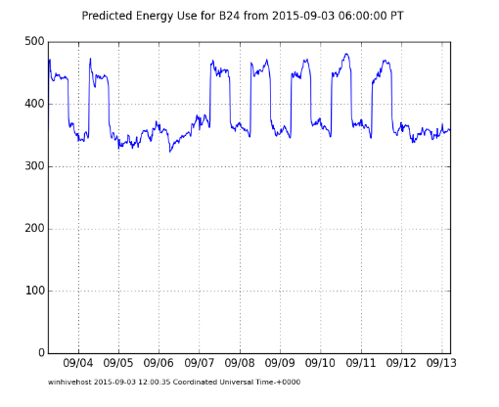
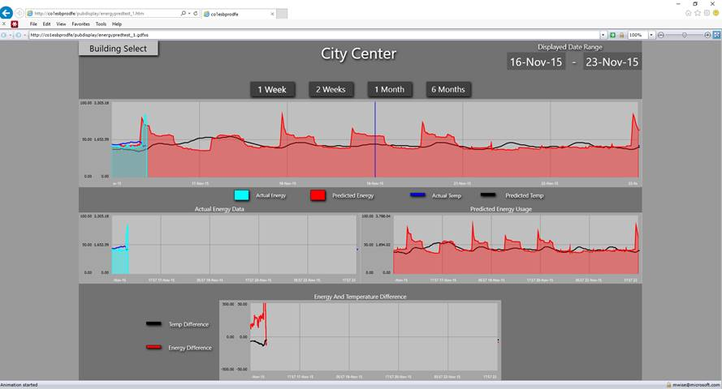
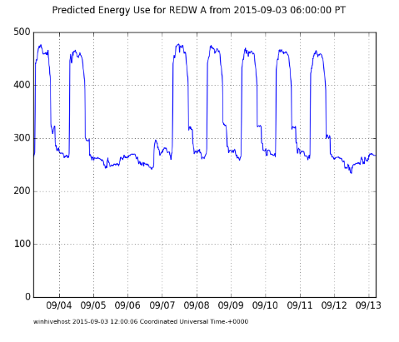
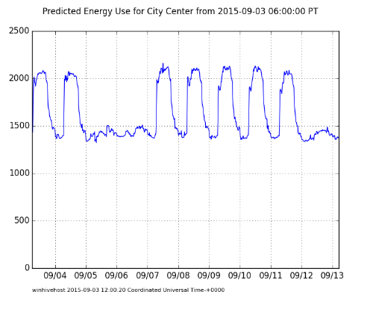
Pilot
21 Buildings with predictions updating once an hour
Models are increasingly out of date, and thus more likely to encounter different weather conditions than they were trained on
Peak Energy Consumption Reduction already possible with this model
Note the prominent peaks (“sharking” or “sharktoothing”) in these images

Slide 4
Goals for Phase 2
Create more accurate energy prediction models
Develop prediction models that can be used for load-shaping control
Specificly building pre-heating to avoid “sharking” or “sharktoothing”
Lowers peak demand charges at the cost of greater enery utilization costs
Create predictive maintenance models for chillers
Redesign prediction architecture so that it can be deployed in Azure in a vendor independent manner

Slide 5
ML for 88 Acers Architecture – Phase 2
Data Orchestration driven by ADF
ADF in development
ADF does not yet support Python Activities, but promised real soon now ☺

Slide 6
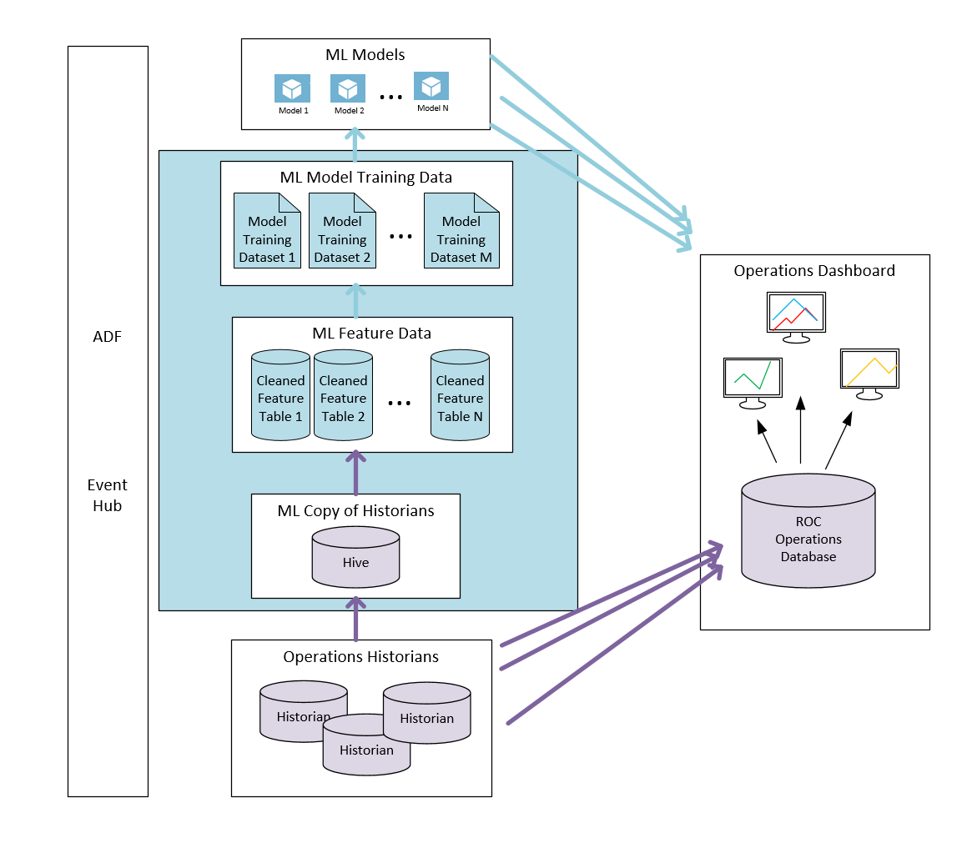
Vendor Independent Data Architecture
Need Vendor Independent Scheme
Haystack might provide valuable guidance
Vendor Independent in Cyan
Vender Specific in Magenta

Slide 7
Phase 1 Energy Prediction Data Flow
We trained up a model in one block
We then used that model for predicting in one block
Data flow was simple
No building state (except headcount)
Predictions are independent of previous predictions

Slide 8
Limitations of approach
Because there is no state, we cannot know if the building is warm
The control variables (occupancy and thermostat settings) are not a part of the model, implicitly accounted for in time variation
Model cannot generalize to a command-and-control model (prescriptive analytics)

Slide 9
Phase 2 Energy Prediction Data Flow
Example of Physics/ML Hybrid Approach
Add state variables and control variables
Results in a time domain ODE
Implies need to train 3 (or more) models per building
The models have to be used step-by-step in prediction
Optimization can be run on resulting model

Slide 10
Phase 2 Energy Control Data Flow
With this model the engineer can control the energy consumption in a predictable way by changing the OCC values centrally

Slide 11
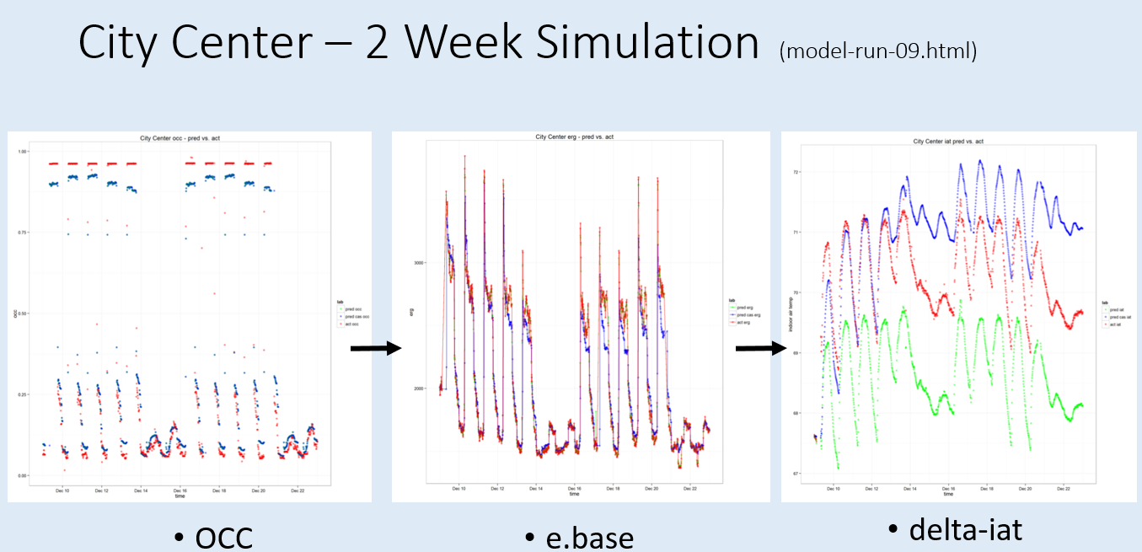
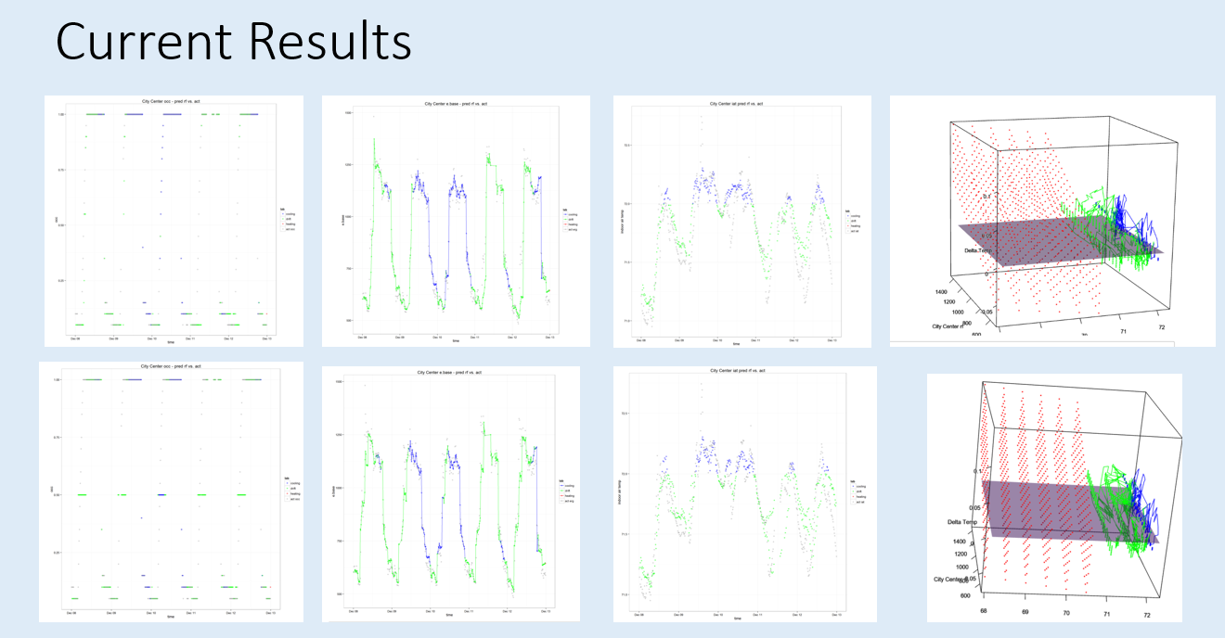
Realization
Need to estimate 3 models instead of one
Prediction implied wire up in a step-wise simulation
Took far longer than anticipated

Slide 12
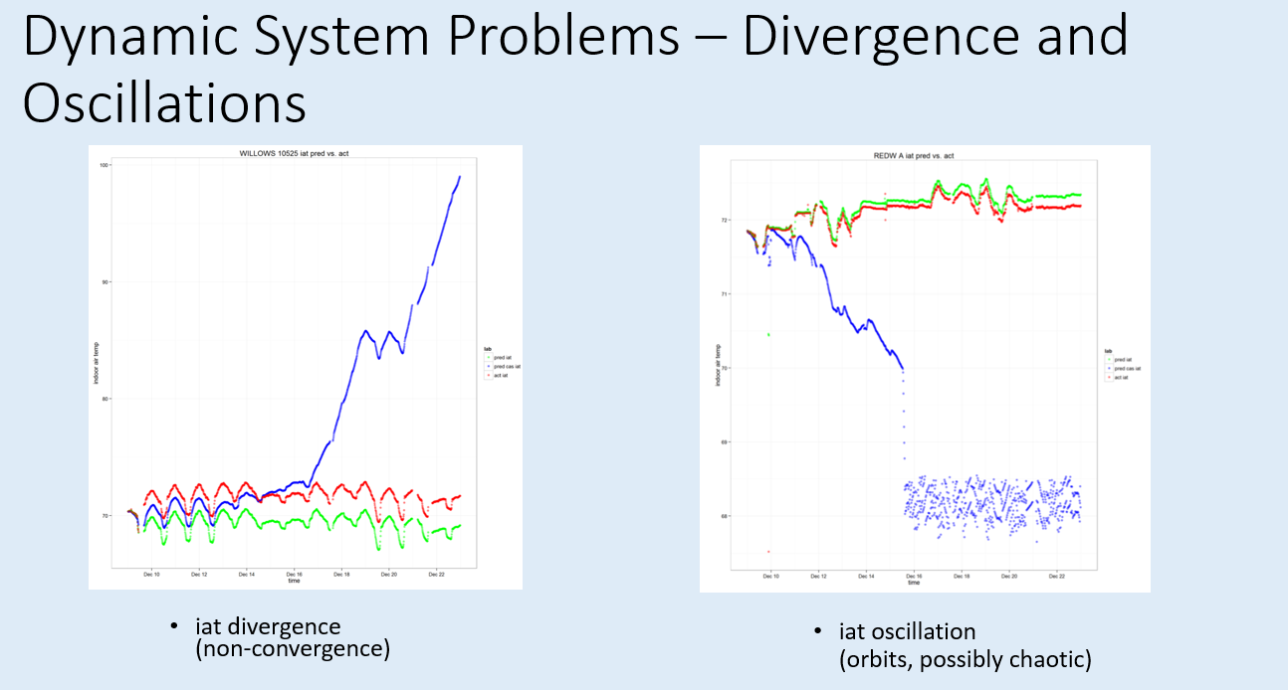
Dynamic Modelling Challenges
Time based ODE is essentially a 3-dimentional dynamic system
It is a simplification of the actual physics that neglects important properties such as conservation of energy.
Depending on ML function estimated can diverge, oscillate, show chaotic and other mostly unrealistic behavior
Adding COE would have make the model more complex and difficult to estimate and not necessarily more accurate for our purposes
Eventuall stabilized the model with a varietiy of measures (dampening, clamping and moving to integral equations)

Slide 13
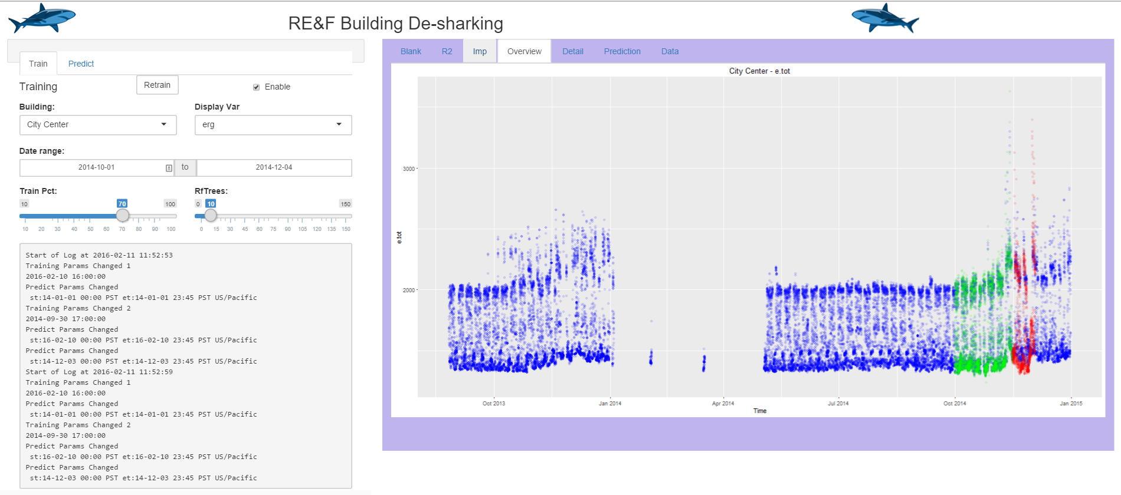
De-sharking Application
Application to allow enginner to determine optimal amount of pre-heating for “de-sharking”
Target implemention was a Jupyter notebook, but moved to Shiny due to beta issues.
Shiny is more mature and can create richer apps from native R
Application has two phases, model training, and pre-heating optimization
Training input and plots depicted here

Slide 14
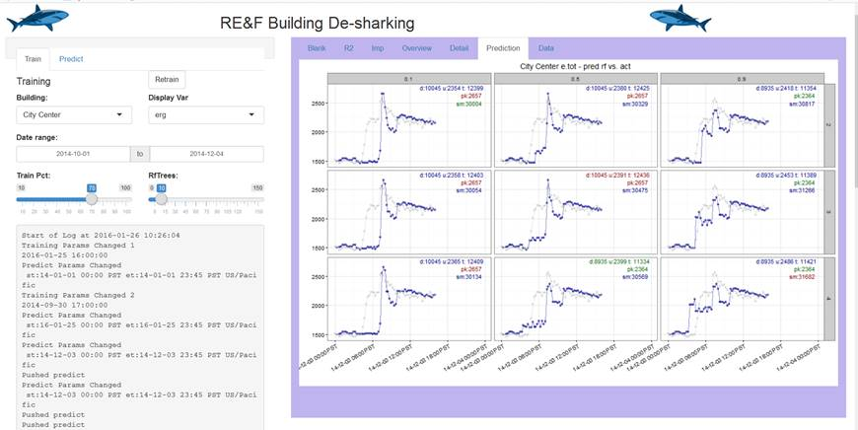
Building Pre-heating Optimization
Optimization plots and
Optimization was designed to be manual at first to allow engineers to gain confidence in the model
Actual optimization space is infinite dimentional since we want to find the best pre-heat function.
Simplified to a 3-dimensional space by looking for best simple step functions

Slide 15
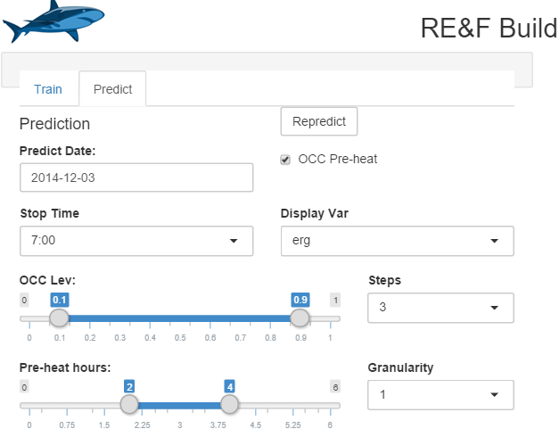
Optimization Controls
Predict date (currently must lie in test range)
Repredict button
OCC Pre-heat enables scenarios
OCC Lev has 3 steps between slider vals
0.1, 0.5, 0.9
Preheat hours has 1 hour granulatity between 2 and 4 hours
2,3,4
So will calculate 9 scenarios

Slide 16
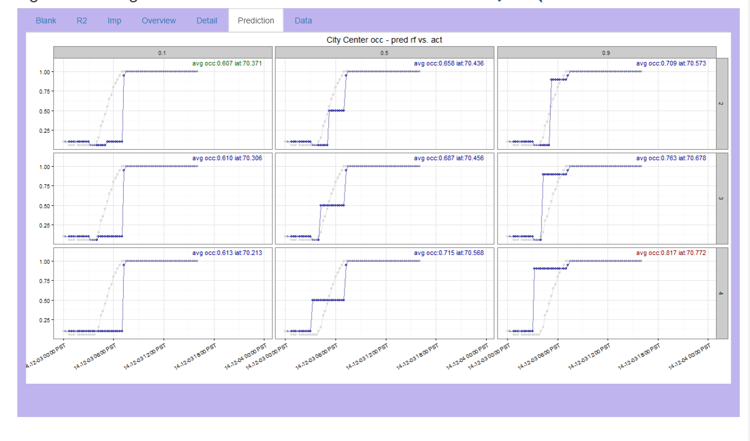
Optimization runs - Occupancy
Scenario values on gray edge panel bars
Top line of numbers is average occupancy and average temperature
occ: occupancy
iat: indoor air Green text is the “best value” in the panels
Grey values are actually measured values
Note that pre-heating was probably done in reality on this building

Slide 17
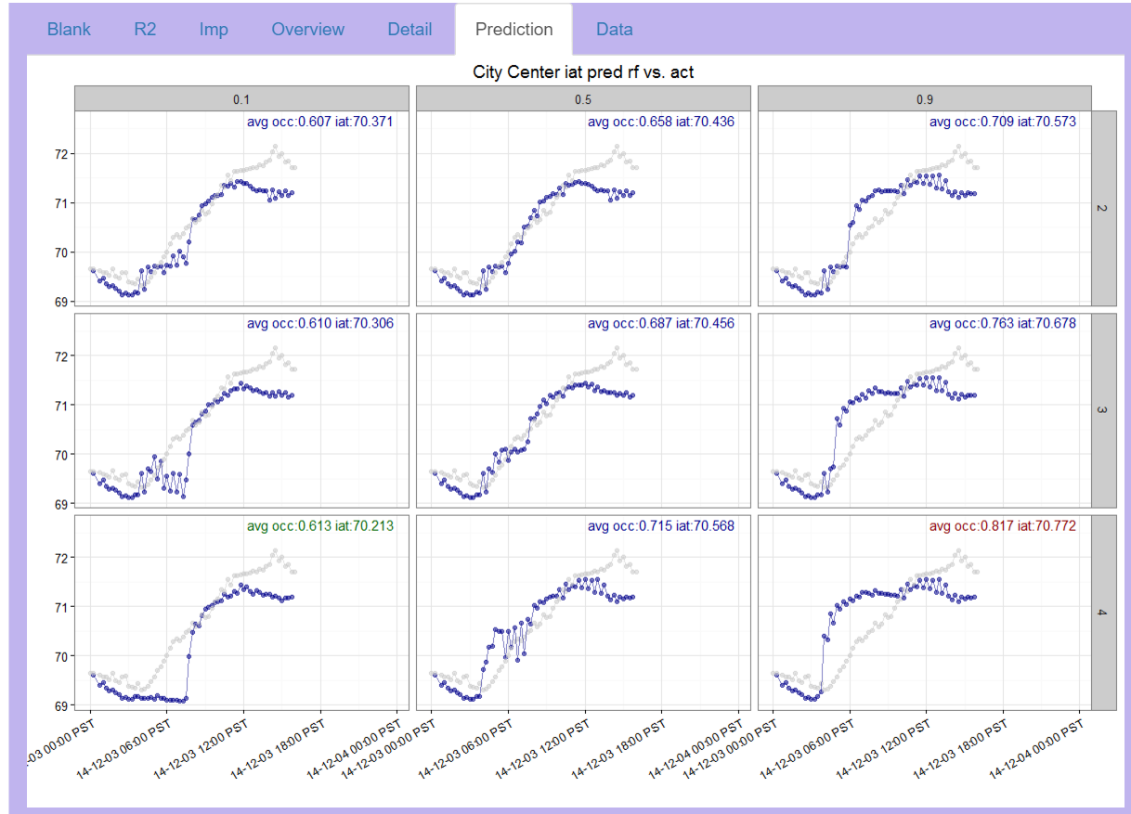
Optimization runs – Indoor Air Tmperatures
Temperatures behave as expected, more occupancy leads to a warmer building
Note occilations, probably a numerical artificat from our model (randomForest based)

Slide 18
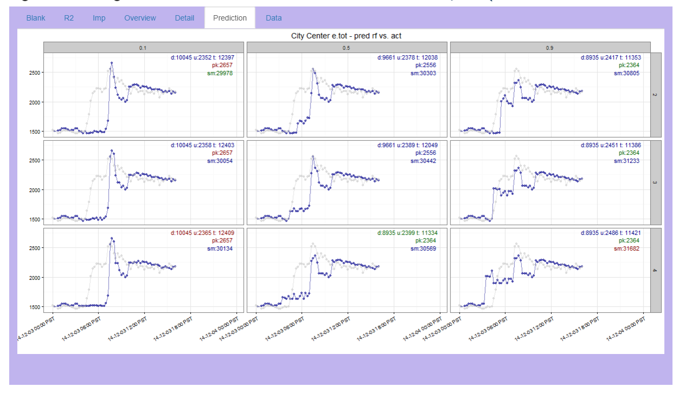
Results
Scenario values on gray edge panel bars
Top line of numbers is cost
d: demand charge
u: usage charge
t: Total charge
Units are currency
Second and third lines technical
pk: peak usage in kW
sm: sum of usage in kW over day
Green text is the “best value” in the panels
Red text is the “worst value” in th panels
Best value here is pre-heat at 0.5 for 4 hours
Could refine grid to find better values

Slide 19
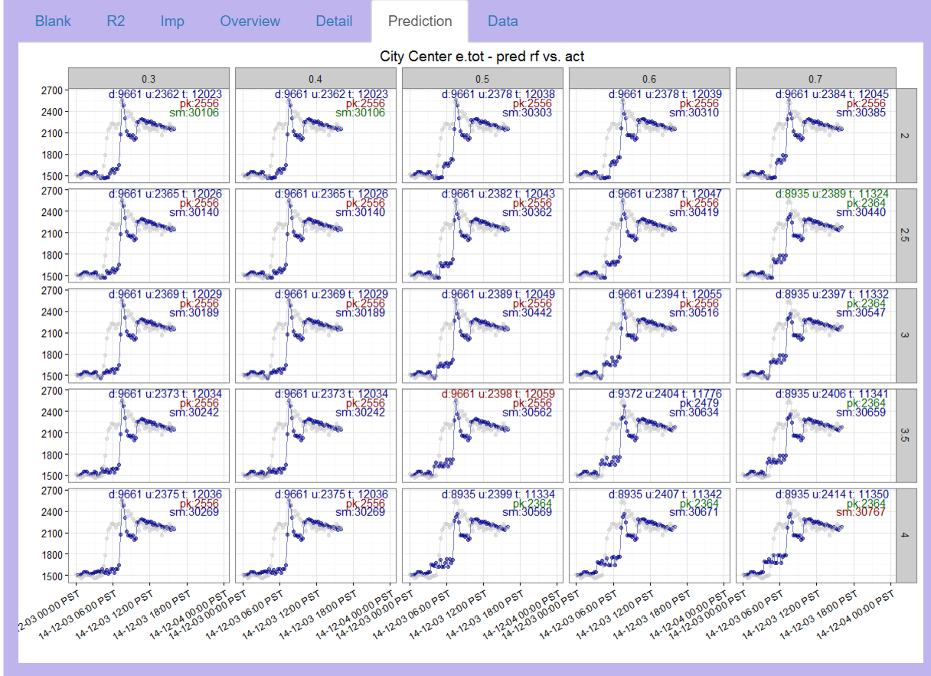

Slide 20
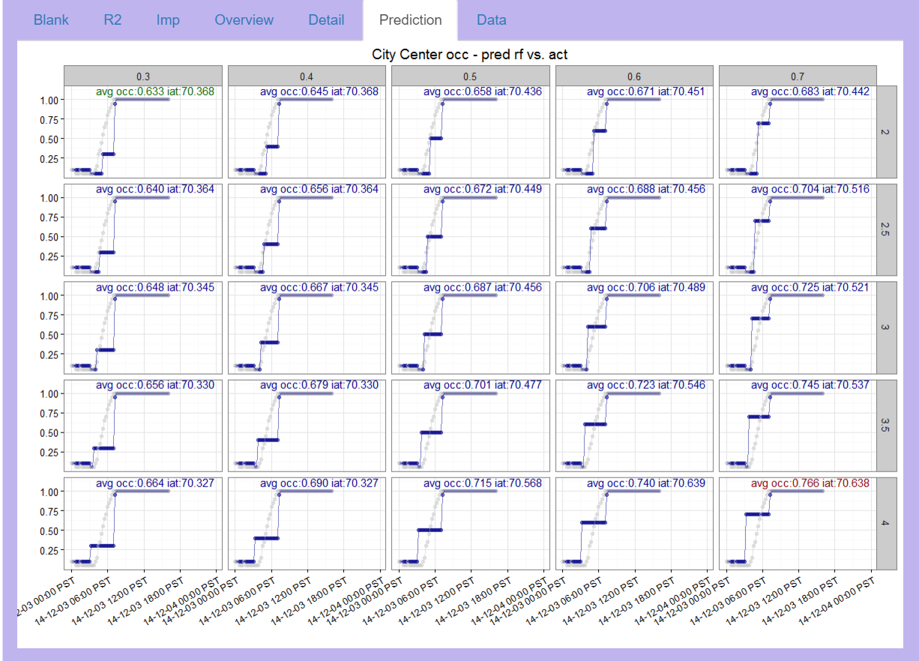

Slide 21
